Slide 1
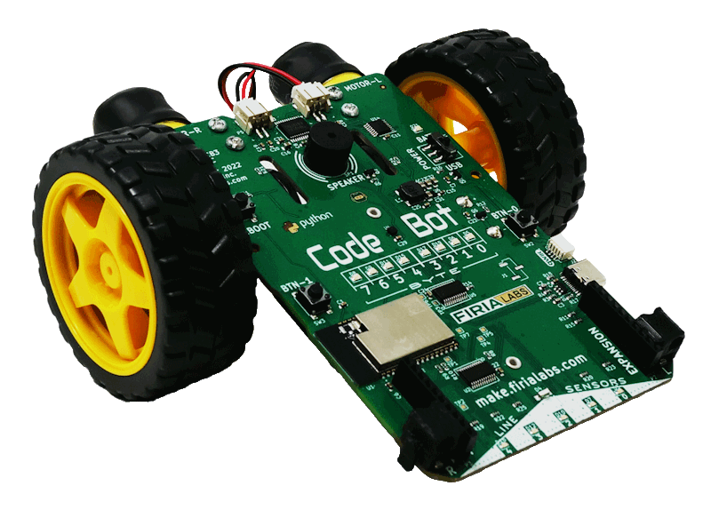
CodeBot Unit 2 Remix
Create your own project based on Mission 4

Slide 2

Time for a project remix!
A remix can be:
A new program created by adding new code to a program you already created
You can combine parts of two or more programs in a remix
Use a similar idea in a different way

Slide 3
Project Remix
Creating a remix will let you:
Improve your skills and practice the concepts from the mission.
Be creative.
Remember code from earlier programs and missions.
Work with other students.
Design an original program and write the code all on your own.

Slide 4
Step #1
Review Mission 4
Open the final program from Mission 4
Animatronics
Review the mission logs from Lesson 1, Lesson 2 and Lesson 3
DO THIS:
Fill out the information in the Planning Guide for Step 1

Slide 5
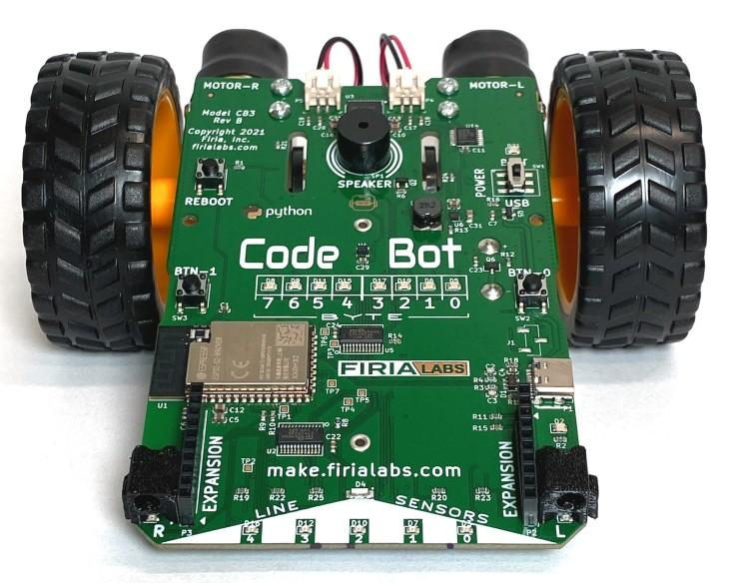
Step #2
Brainstorm ideas
For this project, you will decide on your own animatronics program.
While you were working on the programs for Mission 4, did you ever have your own ideas, or wonder “what if”?
If so, this is your chance!
If you already have your own idea, you are good to go.
If not, read some of the suggestions on the next slide. You can use one of them, or use them as inspiration for your own idea.

Slide 6
Step #2 Remix Ideas
Team Project
You will work in a team for this project. Each team member is responsible for their own program code that will contribute to the overall project.
As a team, decide on an animatronics project, similar to Mission 4, that includes several tasks.

Slide 7
Step #2 Remix Ideas
Lesson Extensions
Look back over the slides for Lessons 1, 2, and 3. Is there an extension that you haven’t tried yet that interests you?
Use one delay variable but different amounts of delay for turning on / off the LEDs.
Increment the delay variable when resetting the n_leds variable.
Use two variables for the LEDs and create a sweeping pattern with two LEDs.
Get a random number between 5 and 15 for the required guests, so the number of guests can be different each time.
Change the tone of the beep with every button press by adding another variable.
Have the ‘bot return to its starting position after it spins.
Turn on a user LED when a note plays.

Slide 8
Step #2 Remix Ideas
Mission 4 Remix Ideas
At the end of Mission 4, several remix suggestions are given:
Make the flashing user LED sequence sweep both ways, left and right.
Increase the number of guests to 15, using binary and leds.ls(num).
Make the button press beep at an increasingly higher frequency with each button press.
Use your note() function to play an enchanting melody while moving forward.

Slide 9
Step #2
Brainstorm ideas
Read through remix suggestions.
Use the suggestions –or–
Use your creativity to come up with your own idea for a project.
Decide what project your team will do.
Decide what task you are responsible for programming.
DO THIS:
Fill out the information in the Planning Guide for Step #2

Slide 10
Step #3
Make a plan
Write an algorithm for your project.
Think about the tasks for the program.
Think about the steps it will take to complete the tasks.
Make a step-by-step plan.
What happens first?
What happens next?
DO THIS:
Fill out the information in the Planning Guide for Step #3

Slide 11

Step #4
Code your project
IMPORTANT: In CodeSpace, go to the sandbox
Start a new file and give it a descriptive name (Remix2)
You can leave other programs open and use them as a guide
Import your libraries
Define your variables and/or constants
Write your code a little bit at a time, testing frequently (divide and conquer!)

Slide 12
Step #4
Stop and test frequently!
Don’t try to write all the code at one time
Think about the steps:
Just get one thing to work, then move on
Step by step!
Mistakes happen, so find them early
Type just a few lines of code and then run the program
If there is an error, fix it before continuing
Use your other programs and classmates for help

Slide 13
Step #4
Documentation!
Make sure your code is readable by adding blank lines
Add comments to sections of your code that explain what they do

Slide 14
Step #5
Get feedback and Revise
Show your code to two team members.
Have them fill out the feedback form on your Planning Guide.
Use the peer reviews to modify your code and make your individual program even better.

Slide 15
Team Project
DO THIS:
Work through the steps on the Team Planning and Review Guide

Slide 16
Step #6
Combine your code into a complete project
IMPORTANT: In CodeSpace, go to the sandbox.
Start a new file and give it a descriptive name (Remix2-complete).
Open the programs you are combining.
Plan the program using the guide.
Use CodeSpace to combine the individual programs into one complete program.

Slide 17
Step #6
Stop and test frequently!
Go step by step!
Mistakes happen, so find them early
If there is an error, fix it before continuing
Make sure your code is readable by adding blank lines
Add comments to sections of your code that explain what they do

Slide 18
Step #7
Get feedback and Revise
Show your code to several people who are not on your team.
Have them fill out the feedback form on your Planning Guide.
Use the peer reviews to modify your code and make your project even better.

Slide 19

And now you have your own remix!
Congratulations!
By completing this remix you have:
learned more about programming
practiced the skills and concepts from the missions
been thinking! And problem solving and much more!

Slide 20

Mission Reflection
Wow! Great job!
Prepare a presentation for the project.
Complete the Post-Remix Reflection in your Planning Guide.

